Slide 1

Chernobyl Chemical Radiation
FEMY C S

Slide 2

This dataset presents the concentration of
Iodine-131 (I-131), Caesium-134 (Cs-134),
and Caesium-137 (Cs-137) as aerosol particles
which were measured in specific location and date.
Several other European countries were affected by
it, due to a massive atmospheric transfer of
Radioactive material. Until this day, the real
impact of this event is still under controversy.

Slide 3
#import all the packages
import pandas as pd
import numpy as np
import matplotlib.pyplot as plt
import seaborn as sns
And then read the data,
Data = pd.read_csv('/content/drive/MyDrive/Chernobyl Chemical Radiation/Chernobyl_ Chemical_Radiation.csv')
Data.head() # it gives the first 5 rows of the data
 | PAYS | Code | Location | Longitude | Latitude | Date | I_131_(Bq/m3) | Cs_134_(Bq/m3) | Cs_137_(Bq/m3)
0 | SE | 1 | RISOE | 12.07 | 55.7 | 86/04/27 | 1 | 0 | 0.24
1 | SE | 1 | RISOE | 12.07 | 55.7 | 86/04/28 | 0.0046 | 0.00054 | 0.00098
2 | SE | 1 | RISOE | 12.07 | 55.7 | 86/04/29 | 0.0147 | 0.0043 | 0.0074
3 | SE | 1 | RISOE | 12.07 | 55.7 | 86/04/29 | 0.00061 | 0 | 0.00009
4 | SE | 1 | RISOE | 12.07 | 55.7 | 86/04/30 | 0.00075 | 0.0001 | 0.00028

Slide 4
Data.tail() # it gives the bottom 5 rows of the data.
Data.shape # gives the shape of the data.
(2051, 9)
 | PAYS | Code | Location | Longitude | Latitude | Date | I_131_(Bq/m3) | Cs_134_(Bq/m3) | Cs_137_(Bq/m3)
2046 | HU | 24 | BUDAPEST | 19.1 | 47.5 | 86/05/07 | 3.7 | 0.58 | 1.2
2047 | HU | 24 | BUDAPEST | 19.1 | 47.5 | 86/05/08 | 2.2 | 0.33 | 0.69
2048 | HU | 24 | BUDAPEST | 19.1 | 47.5 | 86/05/09 | 0.75 | 0.14 | 0.29
2049 | HU | 24 | BUDAPEST | 19.1 | 47.5 | 86/05/10 | 0.054 | 0.006 | 0.009
2050 | HU | 24 | BUDAPEST | 19.1 | 47.5 | 86/05/11 | 0.051 | 0.006 | 0.01

Slide 5
Data.info() # information about each column in the data.
Data.describe() # it describe the numeric coloumns in the data.
Data.columns # to check all column names in the data.
Index(['PAYS', 'Code', 'Location', 'Longitude', 'Latitude', 'Date', 'I_131_(Bq/m3)', 'Cs_134_(Bq/m3)', 'Cs_137_(Bq/m3)'], dtype='object')
Data.rename(columns={"I_131_(Bq/m3)":"Iodine_131",
"Cs_134_(Bq/m3)":"Caesium_134",
"Cs_137_(Bq/m3)":"Caesium_137"},inplace=True)
Data.columns
Index(['PAYS', 'Code', 'Location', 'Longitude', 'Latitude', 'Date', 'Iodine_131', 'Caesium_134', 'Caesium_137'], dtype='object')

Slide 6
Replace the names of the country
Data.replace({'AU': 'Austria',
'BE': 'Belgium',
'CH': 'Switzerland',
'CZ': 'Czechoslovakia',
'DE': 'Germany',
'ES': 'Spain',
'F': 'France',
'FI': 'Finland',
'GR': 'Greece',
'HU': 'Hungary',
'IR': 'Ireland',
'IT': 'Italy',
'NL': 'Netherlands',
'NO': 'Norway',
'SE': 'Sweden',
'UK': 'United Kingdom'},inplace=True)

Slide 7
Data.PAYS.value_counts()
Output:-
Italy 303
France 260
Germany 246
Austria 223
Sweden 211
Czechoslovakia 134
Netherlands 121
United Kingdom 119
Finland 107
Norway 73
Belgium 72
Greece 60
Spain 44
Switzerland 42
Ireland 23
Hungary 13
Name: PAYS, dtype: int64

Slide 8
2051 rows × 8 columns
Data.Location.value_counts()
Data.isna().sum()
Data.drop(["Code"],axis=1,inplace=True)
Data
 | PAYS | Location | Longitude | Latitude | Date | Iodine_131 | Caesium_134 | Caesium_137
0 | Sweden | RISOE | 12.07 | 55.7 | 86/04/27 | 1 | 0 | 0.24
1 | Sweden | RISOE | 12.07 | 55.7 | 86/04/28 | 0.0046 | 0.00054 | 0.00098
2 | Sweden | RISOE | 12.07 | 55.7 | 86/04/29 | 0.0147 | 0.0043 | 0.0074
3 | Sweden | RISOE | 12.07 | 55.7 | 86/04/29 | 0.00061 | 0 | 0.00009
4 | Sweden | RISOE | 12.07 | 55.7 | 86/04/30 | 0.00075 | 0.0001 | 0.00028
... | ... | ... | ... | ... | ... | ... | ... | ...
2046 | Hungary | BUDAPEST | 19.10 | 47.5 | 86/05/07 | 3.7 | 0.58 | 1.2
2047 | Hungary | BUDAPEST | 19.10 | 47.5 | 86/05/08 | 2.2 | 0.33 | 0.69
2048 | Hungary | BUDAPEST | 19.10 | 47.5 | 86/05/09 | 0.75 | 0.14 | 0.29
2049 | Hungary | BUDAPEST | 19.10 | 47.5 | 86/05/10 | 0.054 | 0.006 | 0.009
2050 | Hungary | BUDAPEST | 19.10 | 47.5 | 86/05/11 | 0.051 | 0.006 | 0.01

Slide 9
Data[["Iodine_131","Caesium_134","Caesium_137"]] = Data[["Iodine_131","Caesium_134","Caesium_137"]].replace("<",np.NaN)
Data[["Iodine_131","Caesium_134","Caesium_137"]] = Data[["Iodine_131","Caesium_134","Caesium_137"]].replace("L",np.NaN)
Data[["Iodine_131","Caesium_134","Caesium_137"]] = Data[["Iodine_131","Caesium_134","Caesium_137"]].replace("N",np.NaN)

Slide 10
2051 rows × 8 columns
Data[["Iodine_131","Caesium_134","Caesium_137"]] = Data[["Iodine_131","Caesium_134","Caesium_137"]].apply(pd.to_numeric)
 | PAYS | Location | Longitude | Latitude | Date | Iodine_131 | Caesium_134 | Caesium_137
0 | Sweden | RISOE | 12.07 | 55.7 | 86/04/27 | 1.00000 | 0.00000 | 0.24000
1 | Sweden | RISOE | 12.07 | 55.7 | 86/04/28 | 0.00460 | 0.00054 | 0.00098
2 | Sweden | RISOE | 12.07 | 55.7 | 86/04/29 | 0.01470 | 0.00430 | 0.00740
3 | Sweden | RISOE | 12.07 | 55.7 | 86/04/29 | 0.00061 | 0.00000 | 0.00009
4 | Sweden | RISOE | 12.07 | 55.7 | 86/04/30 | 0.00075 | 0.00010 | 0.00028
... | ... | ... | ... | ... | ... | ... | ... | ...
2046 | Hungary | BUDAPEST | 19.10 | 47.5 | 86/05/07 | 3.70000 | 0.58000 | 1.20000
2047 | Hungary | BUDAPEST | 19.10 | 47.5 | 86/05/08 | 2.20000 | 0.33000 | 0.69000
2048 | Hungary | BUDAPEST | 19.10 | 47.5 | 86/05/09 | 0.75000 | 0.14000 | 0.29000
2049 | Hungary | BUDAPEST | 19.10 | 47.5 | 86/05/10 | 0.05400 | 0.00600 | 0.00900
2050 | Hungary | BUDAPEST | 19.10 | 47.5 | 86/05/11 | 0.05100 | 0.00600 | 0.01000

Slide 11
Data.sort_values(by=["Date"],inplace=True)
Data["Date"] = pd.to_datetime(Data["Date"])
Data["Date"]
Output:-
0 1986-04-27
1651 1986-04-28
1623 1986-04-28
1659 1986-04-28
1200 1986-04-28
...
1234 1986-05-31
1110 1986-05-31
1869 1986-05-31
559 1986-06-05 240
1986-08-04
Name: Date, Length: 2051, dtype: datetime64[ns]

Slide 12
Data
 | PAYS | Location | Longitude | Latitude | Date | Iodine_131 | Caesium_134 | Caesium_137
0 | Sweden | RISOE | 12.07 | 55.70 | 1986-04-27 | 1.000000 | 0.000000 | 0.240000
1651 | Norway | BERGEN | 10.66 | 59.90 | 1986-04-28 | 0.000200 | 0.000000 | 0.000000
1623 | Finland | NURMIJAERVI | 24.70 | 60.45 | 1986-04-28 | 0.000000 | 0.950000 | 1.790000
1659 | Norway | KJELLER | 10.66 | 59.90 | 1986-04-28 | 0.120000 | 0.000000 | 0.020000
1200 | Belgium | MOL | 5.12 | 51.18 | 1986-04-28 | 0.000000 | 0.000000 | 0.000031
... | ... | ... | ... | ... | ... | ... | ... | ...
1234 | Belgium | MOL | 5.12 | 51.18 | 1986-05-31 | 0.000000 | NaN | 0.000000
1110 | United Kingdom | GLASGOW | -4.49 | 56.00 | 1986-05-31 | 0.000000 | 0.017000 | 0.034000
1869 | Sweden | STOCKHOLM | 18.08 | 59.33 | 1986-05-31 | 0.000338 | 0.000177 | 0.000324
559 | Ireland | GLASNEVIN.Dublin | -6.28 | 53.37 | 1986-06-05 | 0.000000 | 0.000000 | NaN
240 | Germany | NORDERNEY | 7.15 | 53.71 | 1986-08-04 | 0.000000 | 0.000000 | 0.000070
2051 rows × 8 columns

Slide 13
Average_Data = Data.groupby(["Location","Date","PAYS"],sort=False).mean()
Average_Data
Average_Data = Average_Data.interpolate(method="linear",axis=0)
 |  |  | Longitude | Latitude | Iodine_131 | Caesium_134 | Caesium_137
Location | Date | PAYS
RISOE | 1986-04-27 | Sweden | 12.07 | 55.70 | 1.000000 | 0.000000 | 0.240000
BERGEN | 1986-04-28 | Norway | 10.66 | 59.90 | 0.000200 | 0.000000 | 0.000000
NURMIJAERVI | 1986-04-28 | Finland | 24.70 | 60.45 | 0.000000 | 2.990000 | 5.030000
KJELLER | 1986-04-28 | Norway | 10.66 | 59.90 | 0.120000 | 0.000000 | 0.020000
MOL | 1986-04-28 | Belgium | 5.12 | 51.18 | 0.000000 | 0.000000 | 0.000031
 | ... | ... | ... | ... | ... | ... | ...
 | 1986-05-31 | Belgium | 5.12 | 51.18 | 0.000000 | 0.011477 | 0.000000
GLASGOW | 1986-05-31 | United Kingdom | -4.49 | 56.00 | 0.000000 | 0.017000 | 0.034000
STOCKHOLM | 1986-05-31 | Sweden | 18.08 | 59.33 | 0.000338 | 0.000177 | 0.000324
GLASNEVIN.Dublin | 1986-06-05 | Ireland | -6.28 | 53.37 | 0.000000 | 0.000000 | 0.000197
NORDERNEY | 1986-08-04 | Germany | 7.15 | 53.71 | 0.000000 | 0.000000 | 0.000070
1414 rows × 5 columns

Slide 14
Average_Data.isna().sum()
Longitude 0
Output:-
Latitude 0
Iodine_131 0
Caesium_134 0
Caesium_137 0
dtype: int64
Data["Iodine_131"].mean()
Data["Caesium_134"].mean()
Data["Caesium_137"].mean()

Slide 15
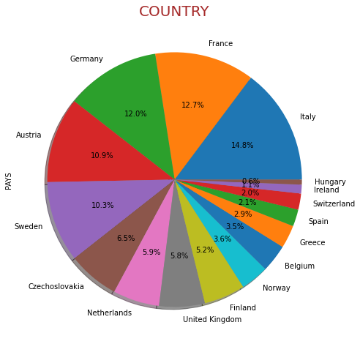
which country is most affected ?
figure = plt.figure(figsize=(20,8))
Data["PAYS"].value_counts().plot.pie(autopct='%1.1f%%',shadow=True)
plt.title('COUNTRY',{'fontsize':20,'color':'brown'})
plt.show()

Slide 16
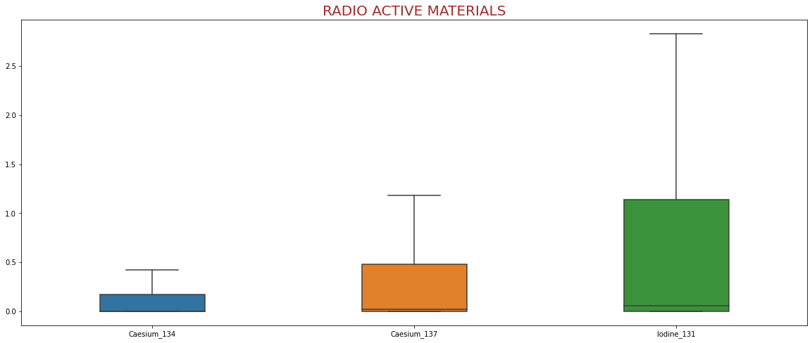
How to find the rate of Radio Active Materials ?
figure = plt.figure(figsize=(20,8))
sns.boxplot(data=Data[["Caesium_134","Caesium_137","Iodine_131"]], width=0.4, showfliers=False)
plt.title('RADIO ACTIVE MATERIALS',{'fontsize':20,'color':'brown'})
plt.show()

Slide 17
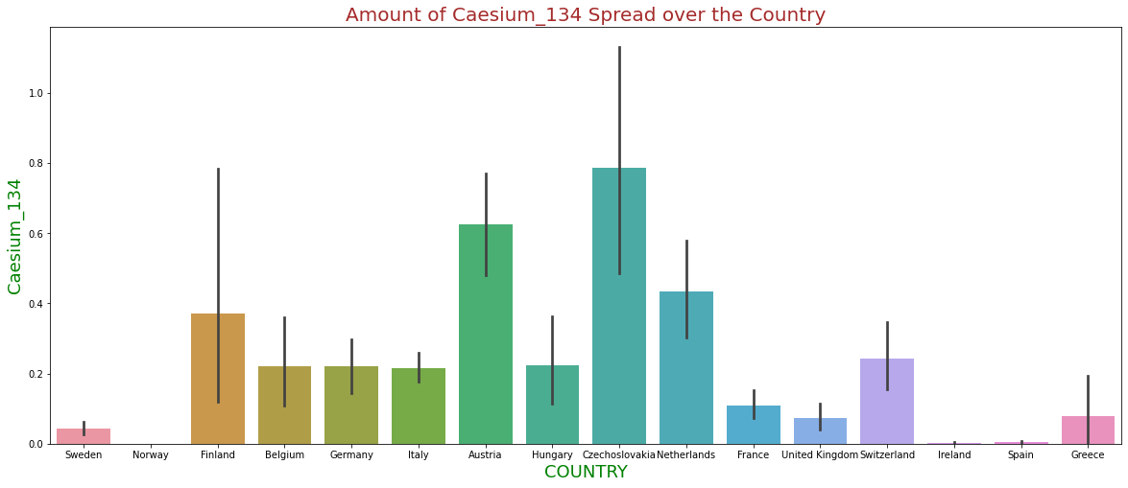
How much Caesium_134 spread over the country ?
plt.figure(figsize=(25,10))
sns.barplot(x='PAYS',y='Caesium_134',data=Data)
plt.title("Amount of Caesium_134 Spread over the Country",{"fontsize":20,"color":"brown"})
plt.legend()
plt.xlabel("COUNTRY",{"fontsize":18,"color":"green"})
plt.ylabel("Caesium_134",{"fontsize":18,"color":"green"})
plt.show()

Slide 18
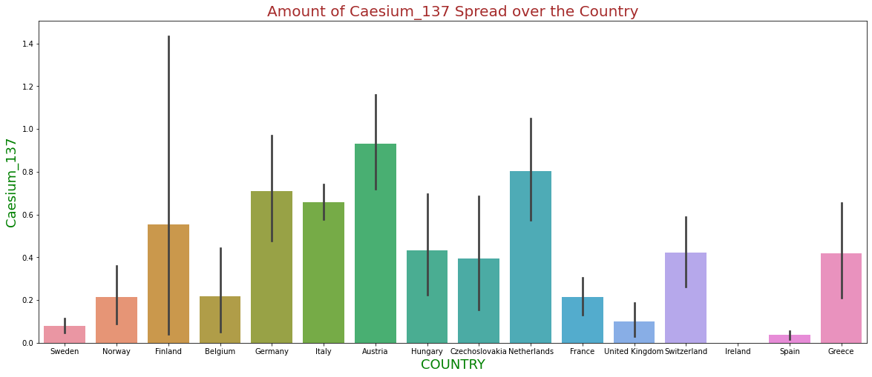
How much Caesium_137 spread over the country ?
sns.barplot(x='PAYS',y='Caesium_137',data=Data)

Slide 19
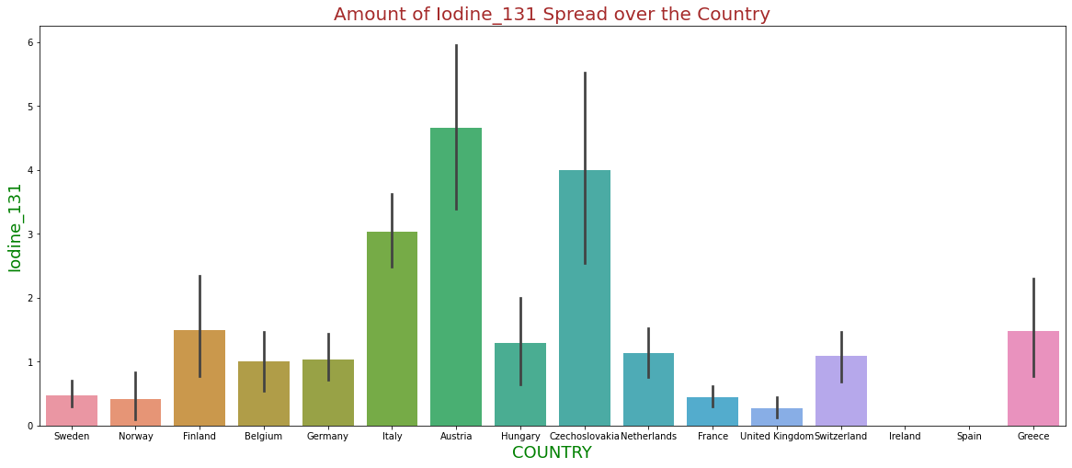
How much Iodine_131 spread over the country ?
sns.barplot(x='PAYS',y='Iodine_131',data=Data)

Slide 20
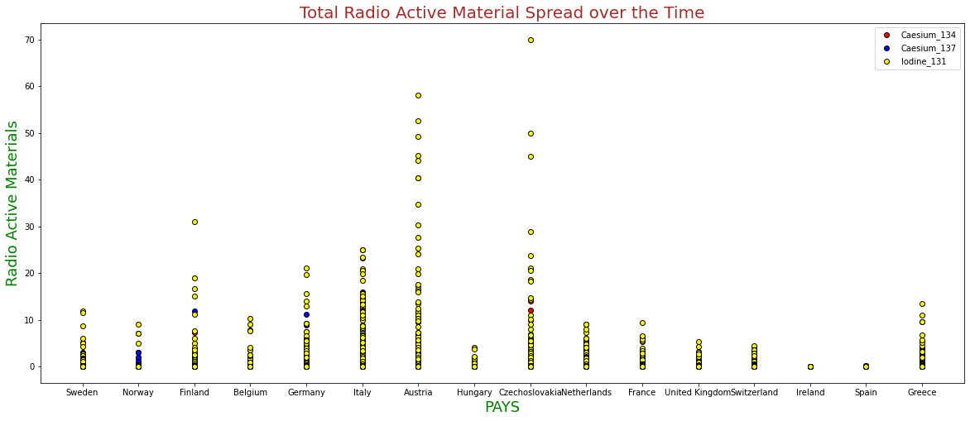
Total rate of Radio Active Materials spread over the country ?

Slide 21
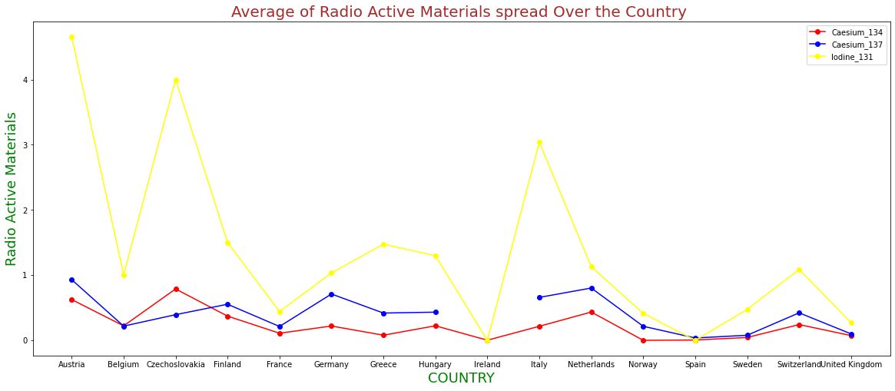
Average rate of total Radio Active Materials spread over the country ?
plt.plot(Data.groupby(["PAYS"])["Caesium_134"].mean(),label="Caesium_134",marker="o",color="red")
plt.plot(Data.groupby(["PAYS"])["Caesium_137"].mean(),label="Caesium_137",marker="o",color="blue")
plt.plot(Data.groupby(["PAYS"])["Iodine_131"].mean(),label="Iodine_131",marker="o",color="yellow")

Slide 22
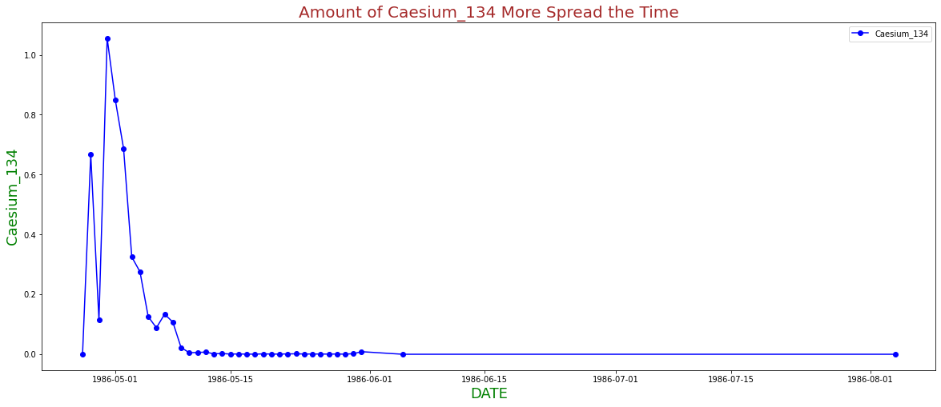
which time is Caesium_134 more spread ?
figure = plt.figure(figsize=(20,8))
plt.plot(Data.groupby(["Date"])["Caesium_134"].mean(),label="Caesium_134",marker="o",color="blue")
plt.title("Amount of Caesium_134 Spread the Time",{"fontsize":20,"color":"brown"})
plt.legend()
plt.xlabel("DATE",{"fontsize":18,"color":"green"})
plt.ylabel("Caesium_134",{"fontsize":18,"color":"green"})
plt.show()

Slide 23
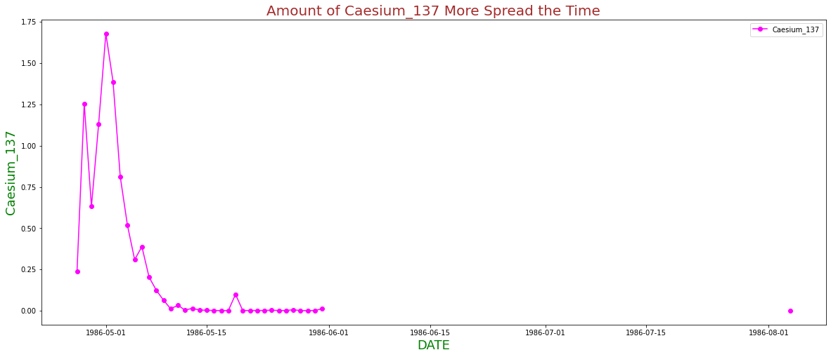
which time is Caesium_137 more spread?
plt.plot(Data.groupby(["Date"])["Caesium_137"].mean(),label="Caesium_137",marker="o",color="magenta")

Slide 24
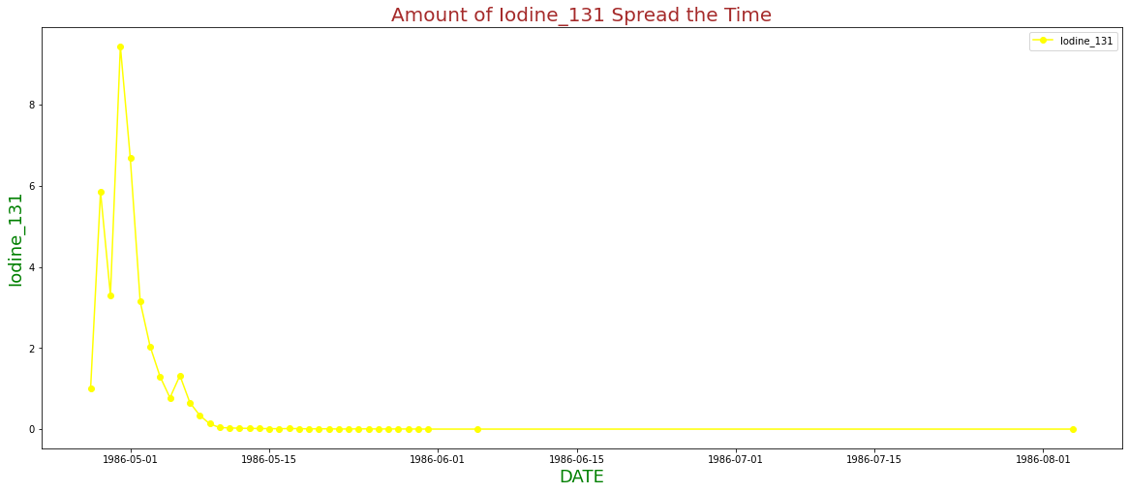
which time is Iodine_131 more spread?
plt.plot(Data.groupby(["Date"])["Iodine_131"].mean(),label="Iodine_131",marker="o",color="yellow")

Slide 25
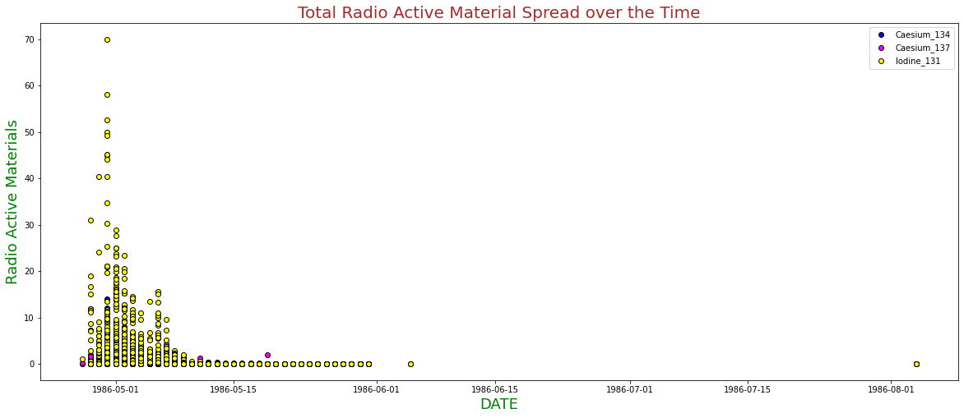
which time the Radio Active Materials mostly spreaded ?

Slide 26
which location is most affected in Caesium_134 ?
figure = plt.figure(figsize=(40,20))
plt.scatter(x=Data["Caesium_134"],y=Data["Location"],label="Caesium_134",color="red")
plt.title("Amount of Iodine_131 Spread over the Time",{"fontsize":30,"color":"brown"})
plt.legend()
plt.xlabel("DATE",{"fontsize":25,"color":"green"})
plt.ylabel("Location",{"fontsize":25,"color":"green"})
plt.show()

Slide 27
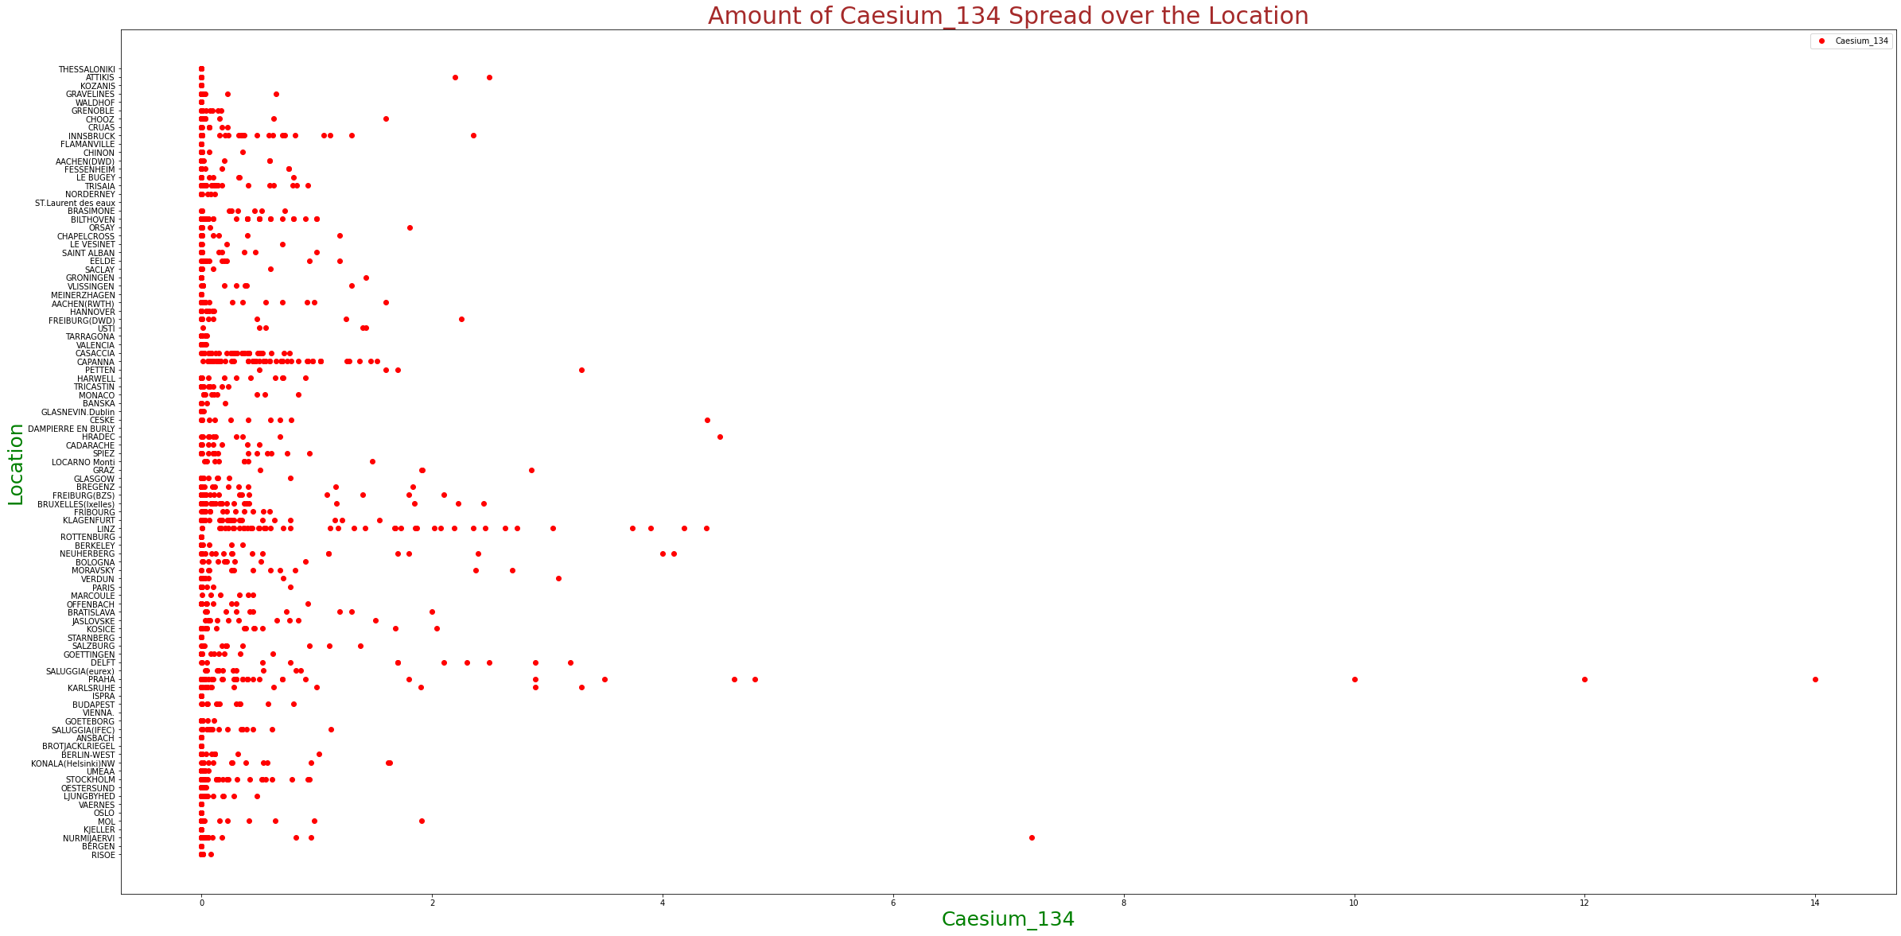

Slide 28
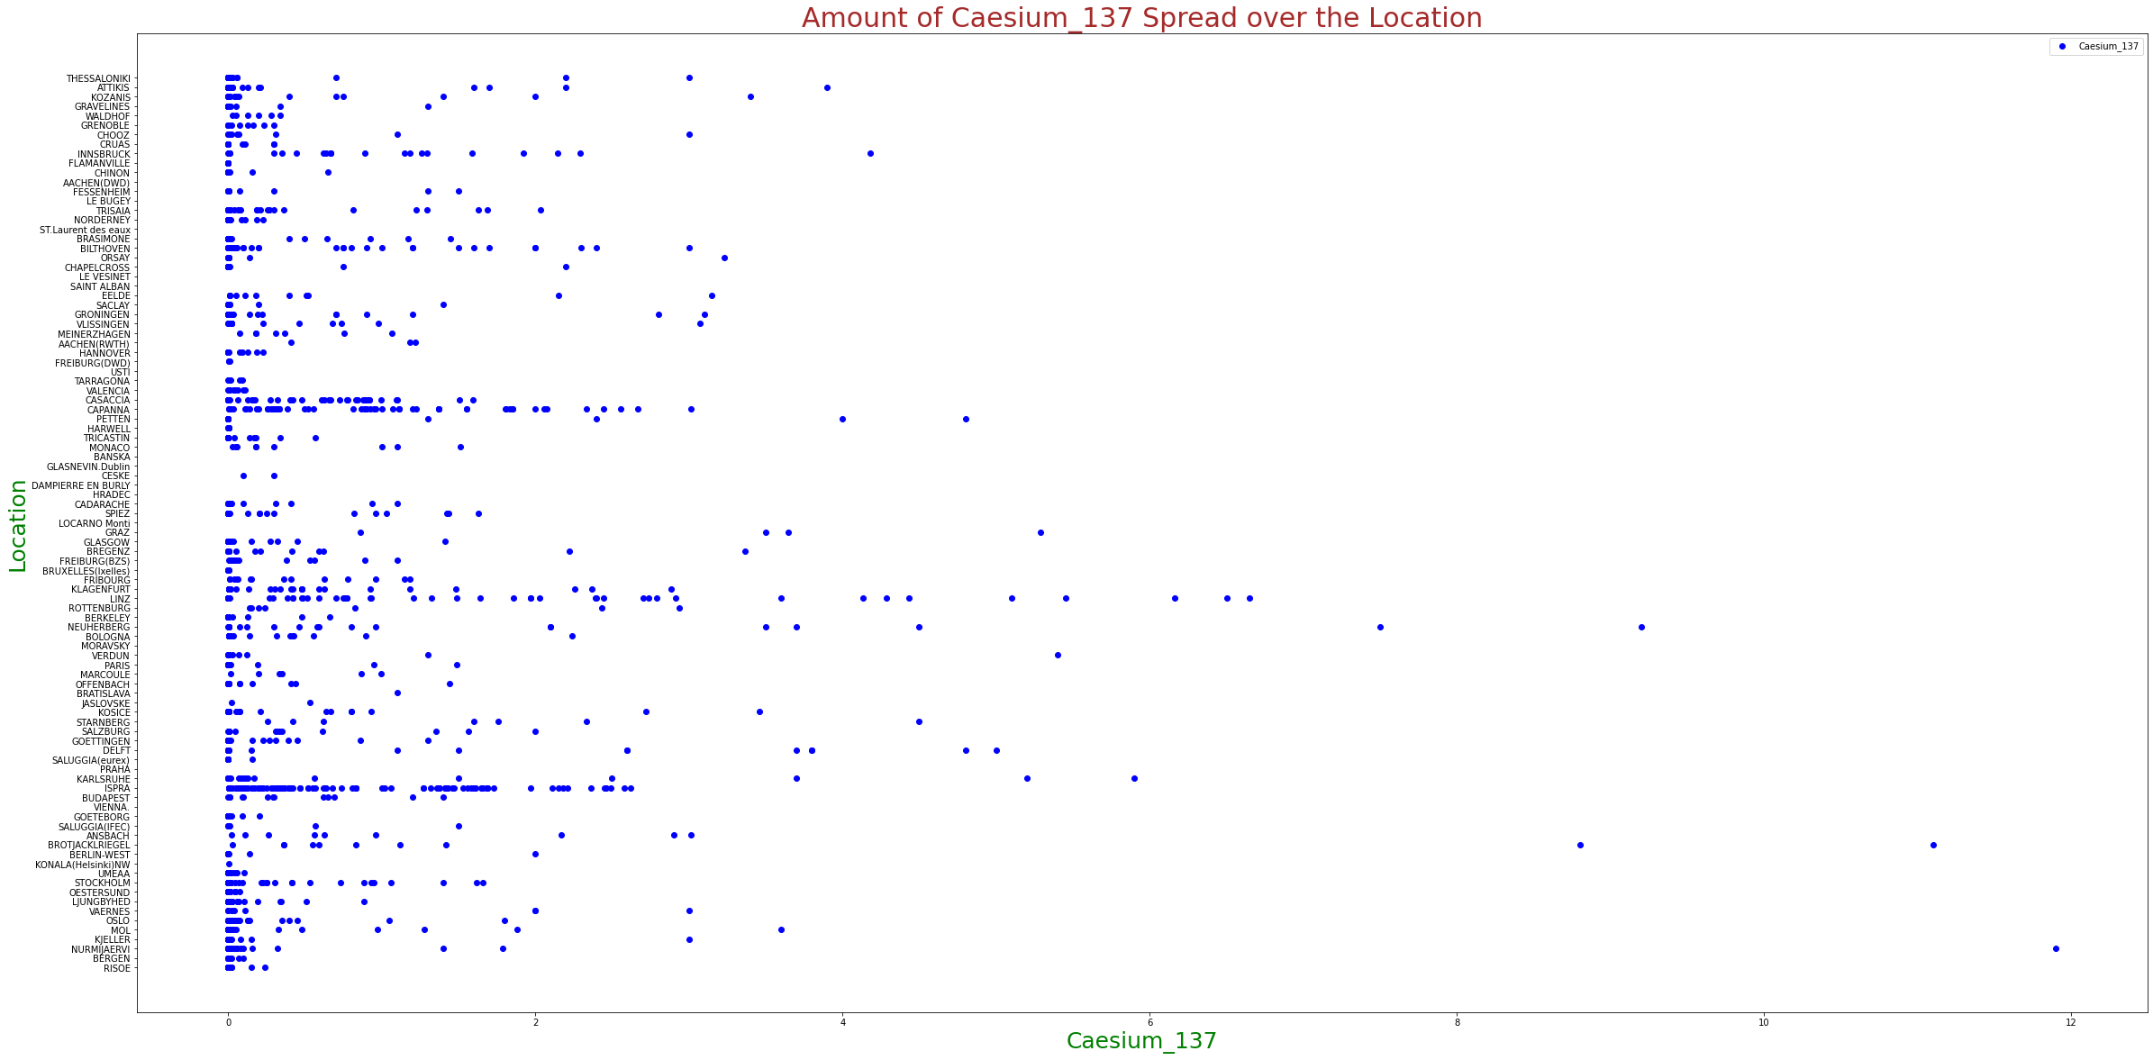
which location is most affected in Caesium_137 ?
plt.scatter(x=Data["Caesium_137"],y=Data["Location"],label="Caesium_137",color="blue")

Slide 29
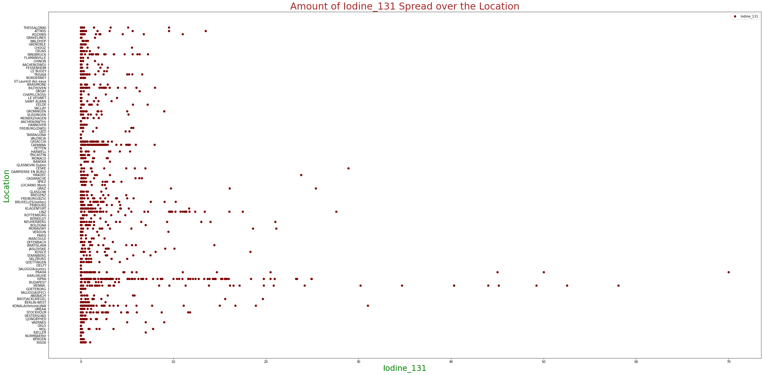
which location is most affected in Iodine_131 ?
plt.scatter(x=Data["Iodine_131"],y=Data["Location"],label="Iodine_131",color="maroon")

Slide 30
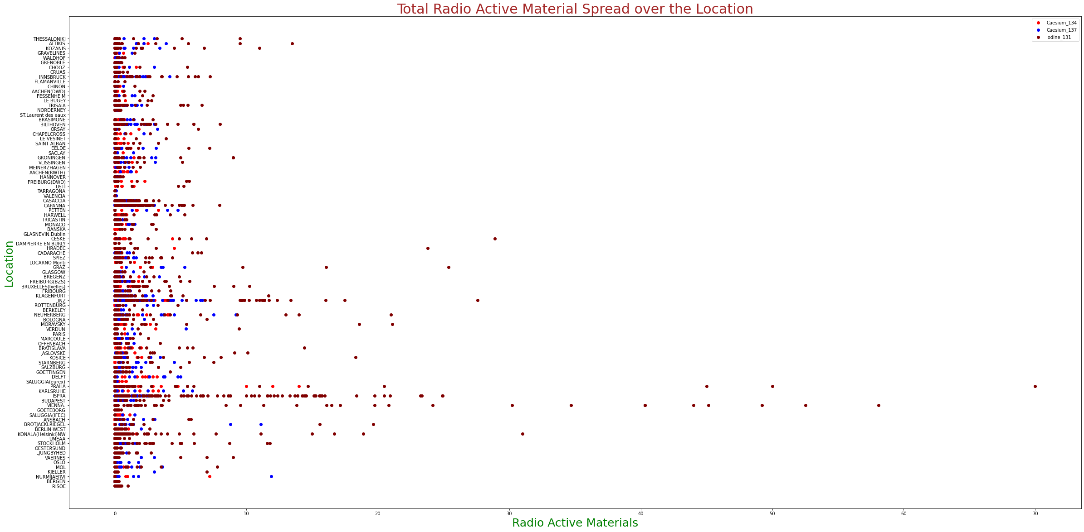
Total rate of Radio Active Materials spread over the location ?

Slide 31
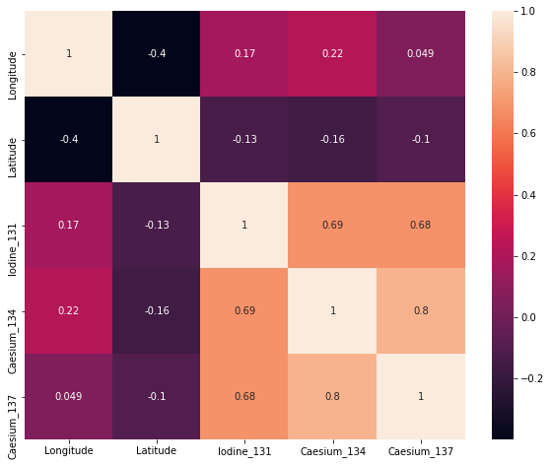
Correlation Data

Slide 32


